Slide 1
Chapter 8

Slide 2
Objectives

Slide 3
Objectives (continued)

Slide 4
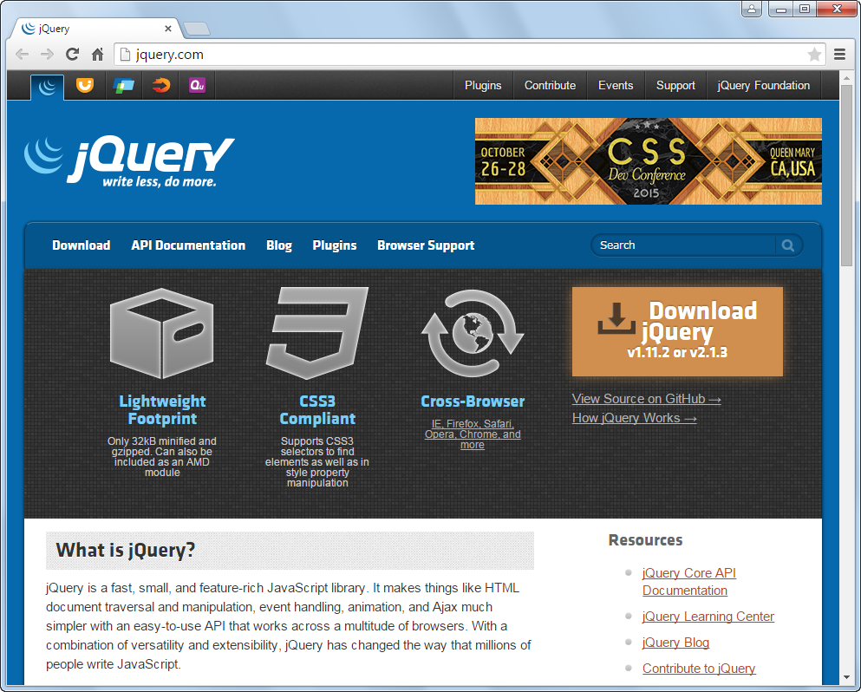
The jQuery website at www.jQuery.com

Slide 5
What jQuery offers

Slide 6
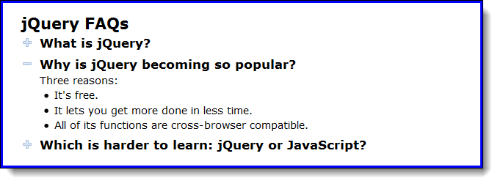
The FAQs application in a browser

Slide 7
The HTML

Slide 8
The critical CSS

Slide 9
The jQuery for the FAQs application

Slide 10
The jQuery download page

Slide 11
How to include jQuery 3.1.1 after you’ve downloaded it to your computer

Slide 12
The most important releases of jQuery

Slide 13
Two jQuery migrate plugins

Slide 14
How to include SRI checking with the jQuery CDN

Slide 15
The syntax for a jQuery selector

Slide 16
The HTML for the selected elements

Slide 17
How to select elements by element, id, and class

Slide 18
How to select elements by relationship

Slide 19
How to code multiple selectors

Slide 20
The syntax for calling a jQuery method

Slide 21
using .val()
const input = $('#input').val();
$('#output').val(input + 32); // correct
$('#output').val() = input + 32; // wrong

Slide 22
Examples that call jQuery methods

Slide 23
The syntax for a jQuery event method

Slide 24
How to code an event handler for the ready event

Slide 25
An event handler for the click event of all h2 elements

Slide 26
Terms

Slide 27
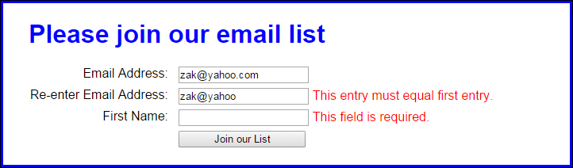
The user interface for the Email List application

Slide 28
The HTML for the Email List application

Slide 29
The HTML (continued)

Slide 30
The jQuery for the Email List application

Slide 31
The jQuery (continued)

Slide 32
Some of the most useful jQuery selectors

Slide 33
Examples that use jQuery selectors

Slide 34
Some of the most useful jQuery methods

Slide 35
Examples that use jQuery methods

Slide 36
Examples that use jQuery methods (continued)

Slide 37
Some of the most useful jQuery event methods

Slide 38
Examples that use jQuery event methods

Slide 39
A preventDefault method that stops the default action of an event

Slide 40
Other event methods that you should be aware of

Slide 41
How to attach an event handler to an event

Slide 42
How to attach an event handler to two different events

Slide 43
How to remove an event handler from an event

Slide 44
How to trigger an event

Slide 45
The FAQs application in a browser

Slide 46
The HTML for the FAQs application

Slide 47
The critical CSS for the FAQs application

Slide 48
The jQuery for the FAQs application

Slide 49

The user interface for the Image Swap application

Slide 50
The HTML for the image swap application

Slide 51
The CSS for the li elements

Slide 52
The JavaScript for the Image Swap application

Slide 53
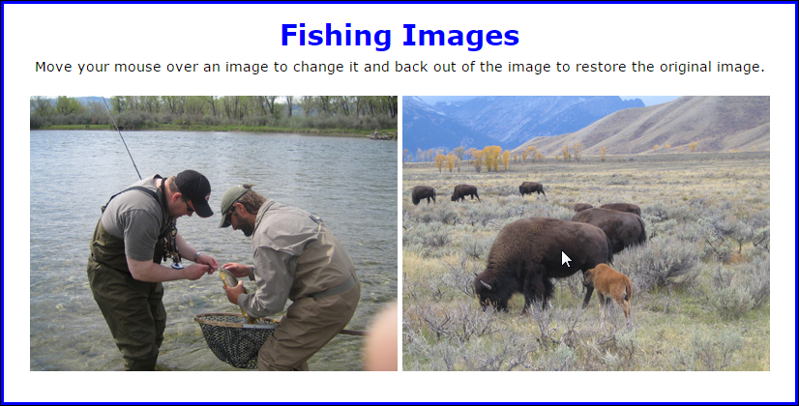
Two images with the second image rolled over

Slide 54
The HTML for the Image Rollover application

Slide 55
The JavaScript for the Image Rollover application

Slide 56
Exercise 8-3 Develop a Book List application

Slide 57
Extra 8-1 Develop an Expand/Collapse application

Slide 58
Extra 8-2 Develop an Image Gallery application

Slide 59
Short 8-1 Modify the Future Value application

Slide 60
Short 8-2 Create a FAQs Rollover application

